Slide 1



SELENIUM
HDSC PREMIERE PROJECT
FORECASTING FX RATES (2000 - 2019)
27TH AUGUST 2022

Slide 2
PRESENTERS
ABDULHAMID IBRAHIM
VISHAL GARG

Slide 3


AGENDA
1
OBJECTIVE
2
OUR APPROACH
3
EDA / ML MODEL
4
CONCLUSION

Slide 4

OBJECTIVE
THE OBJECTIVE IS TO PRODUCE DIRECTIONAL FX FORECASTS THAT ARE ABLE TO YIELD PROFITABLE INVESTMENT STRATEGIES. HENCE, WE APPROACH THE PROBLEM WITH THE FOLLOWING MODELS
a) Logistic Regression
b) ARIMA
c) Prophet
Through the multiple machine learning generated forecasts solve a single problem by designing a profitable FX strategy

Slide 5

OUR APPROACH
WE CONDUCTED A TIME SERIES ANALYSIS AND BUILT 3 MACHINE LEARNING MODELS TO PREDICT FUTURE VALUES AND GOT THE BEST PERFORMING MODEL IN TERMS OF ACCURACY.
Linear Regression
ARIMA
Prophet

Slide 6
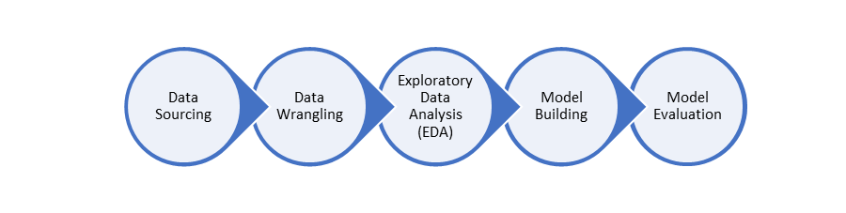
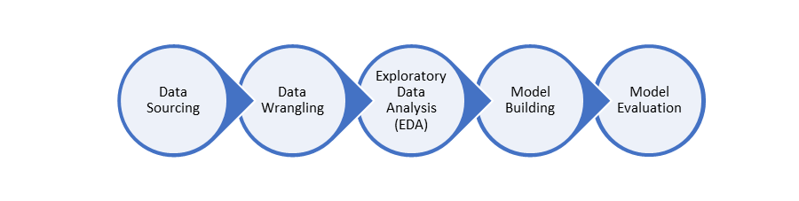
WORKFLOW

Slide 7

DATASET DESCRIPTION
THIS DATASET USED FOR THIS PROJECT WAS obtained on the Kaggle website.
The dataset contains some currencies in with their rates in dollar units

Slide 8
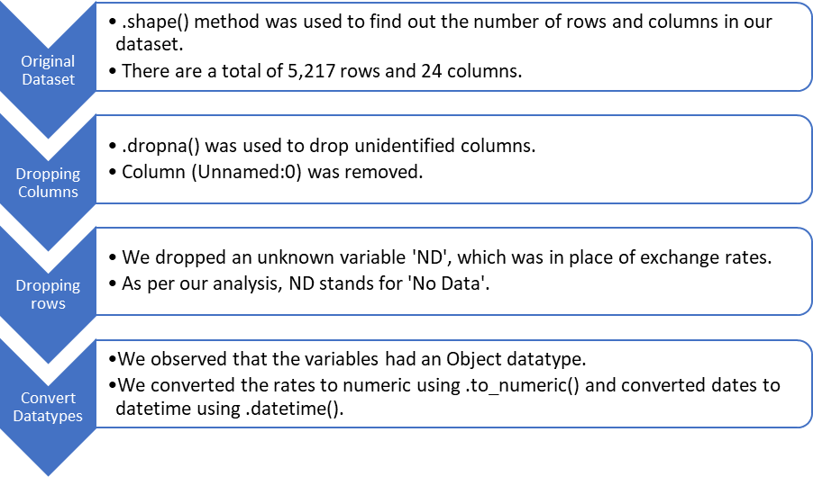
DATA WRANGLING

Slide 9
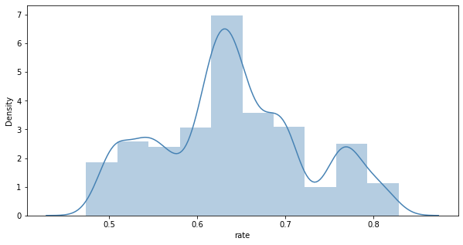
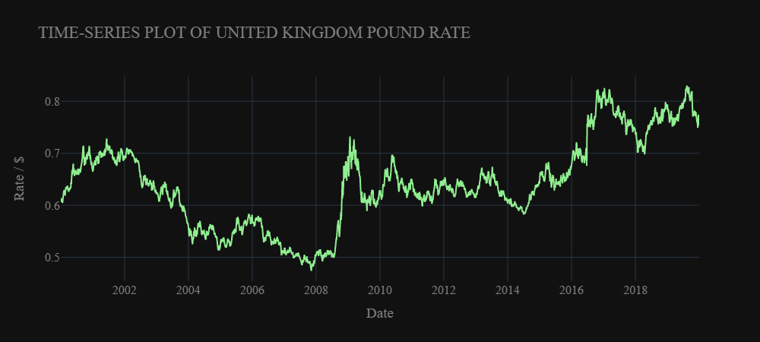
EXPLORATORY DATA ANALYSIS
DENSITY PLOT
TIME-SERIES PLOT
The density plot follows a guassian distribution pattern as it is bell-shaped in nature.
The line plot shows non-stationary, with a trend and no observable Seasonality.
UK pound appreciated in 2008 and depreciated around 2017.

Slide 10
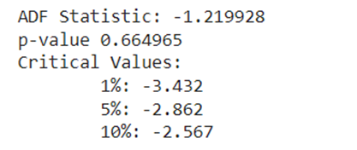
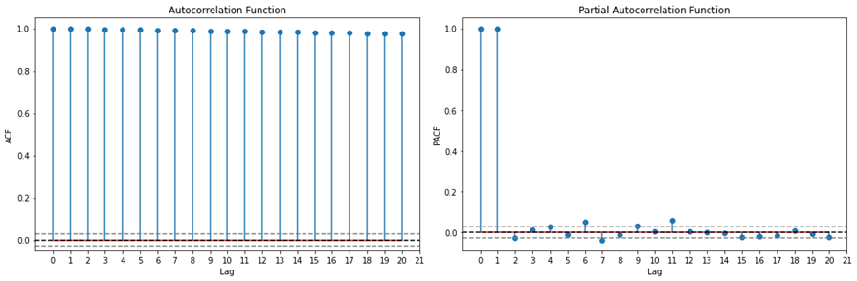
ADF STATISTIC, P-VALUE AND AUTO CORRELATION & PARTIAL ACF
ACF and PACF plots of GBP data series before differencing.
The p-value obtained is greater than the 0.05 threshold from the ADF test.

Slide 11
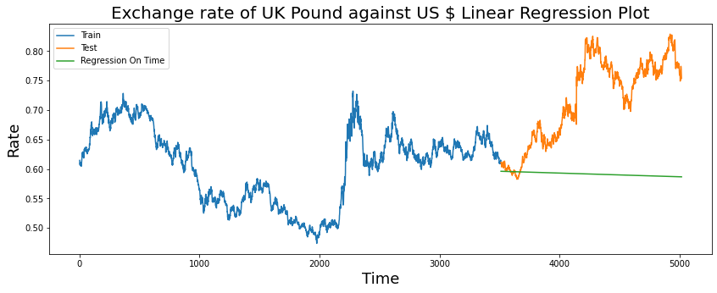
LINEAR REGRESSION MODEL
PREDICTION GRAPH

Slide 12
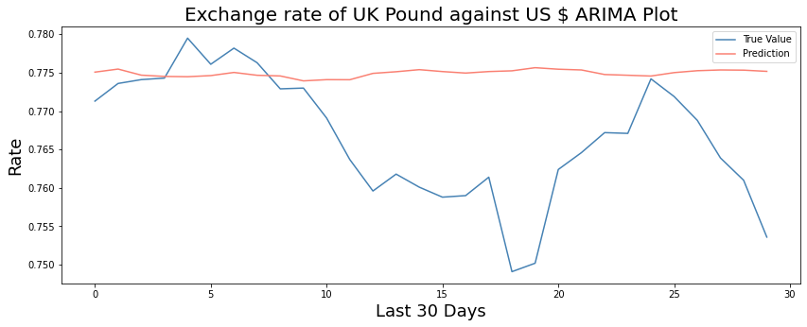
ARIMA MODEL
TRUE VALUE AND PREDICTION OF FUTURE EXCHANGE RATES

Slide 13
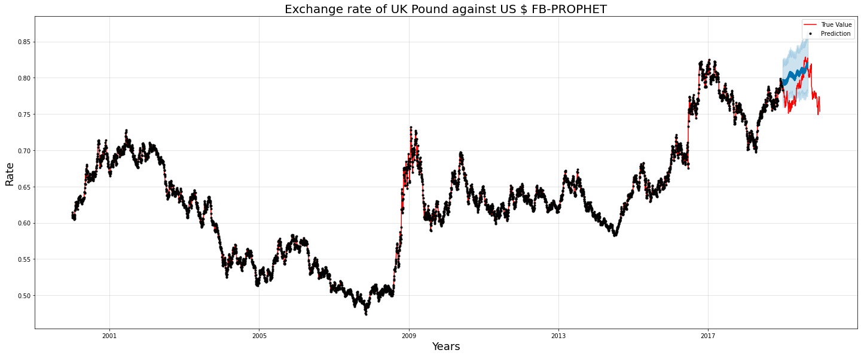
FBPROPHET MODEL
PREDICTION GRAPH

Slide 14

RESULT ANALYSIS
 | Linear Regression | ARIMA | Prophet
Mean Absolute Percentage Error | 16.82% | 1.20% | 3.30%
Mean Absolute Error | 0.12699153 | 0.00911963 | 0.02552403
Mean Squared Error | 0.02134323 | 0.00013793 | 0.00091429
Root Mean Squared Error | 0.14609323 | 0.01174423 | 0.03023724

Slide 15

SUMMARY
THE ANALYSIS FROM THE THREE MODELS CLEARLY SHOWS THAT ARIMA MODEL HAS THE LOWEST MAPE OF ABOUT 1.19%, WHICH MEANS IT HAS THE HIGHEST ACCURACY.
OTHER EVALUATION MATRIC INCLUDES MAE, MSE & RSME
It was also observed that according to ARIMA Model, it perfectly predicted a 30days exchange rate and thus, the UK currency will depreciate as against USD.

Slide 16
THANK YOU!!!

